Slide 1
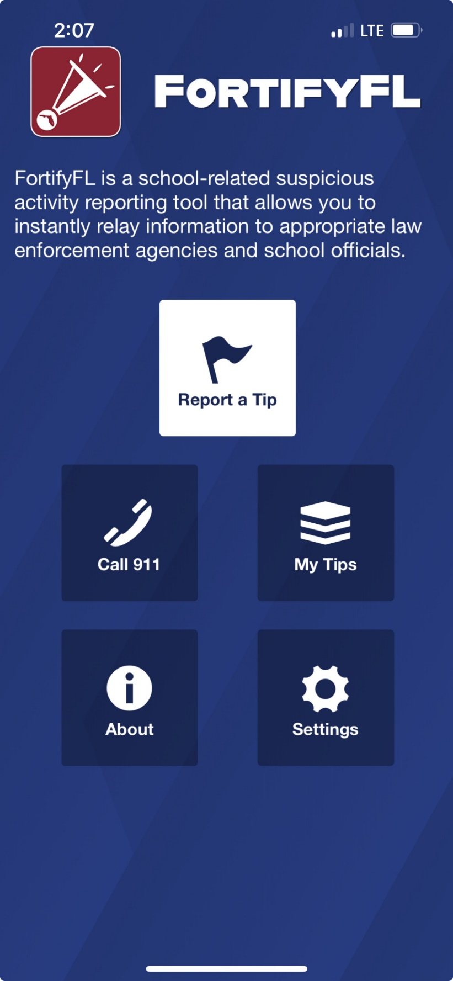


Anonymous Reporting App for reporting concerning behaviors and threats
Notes:
Suggested talking points:
The safety of our students is very important.
FortifyFL is a website and an app where anyone can report safety concerns.

Slide 2

You Should Know:
There is an anonymous reporting app that allows you to instantly send information about suspicious activity.
Notes:
Anyone can choose to remain anonymous using the FortifyFL website or app.

Slide 3
See Something, Hear Something, SAY Something
With FortifyFL, you can submit tips about potential crimes or threats which are sent directly to law enforcement and designated school personnel.
Notes:
See Something, Hear Something, Say Something, Do Something.
Users can instantly send information about suspicious activity, crime, serious threats, etc., to local law enforcement and school officials.

Slide 4

What are concerning behaviors or warning signs that I might see or hear?
Notes:
Let’s take a look at what concerning beheaviors might look like in another student.

Slide 5
What do I do if I see or hear something concerning?
Immediately report the information one of the these ways:
In person to a school administrator at your school
Make a report using FortifyFL (ANYTIME)
Make a report using the Anonymous App (24/7)
Call 850-922-KIDS (5437)
Notes:
Students must report concerning behaviors IMMEDIATELY through some means. If you are not on a school campus when you see or hear something, you can report it anonymously through an app or call our District Security Center which is staffed 24 hours a day, 7 days a week.

Slide 6
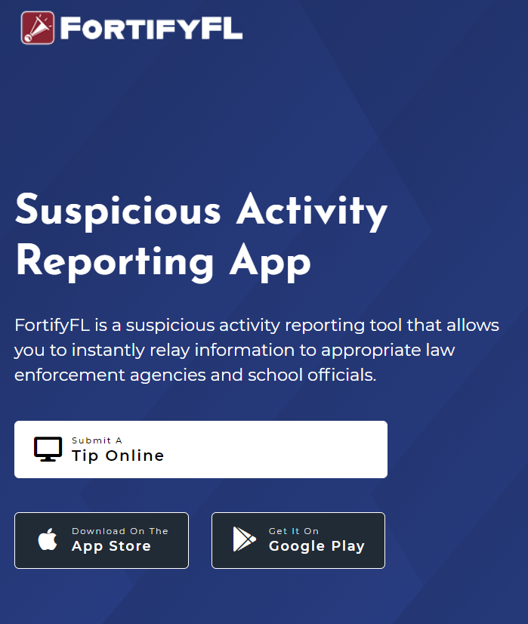
How do I submit a tip?
You can submit a tip from any computer at: GetFortifyFL.com

Slide 7


How do I submit a tip?
You can also submit a tip using your phone. Download the FortifyFL App on your phone or tablet.

Slide 8
How do I submit a tip?
Tips must have actionable information.
This means including WHO did WHAT, WHERE it happened and WHEN.
More tip details improve the chances that a situation can be resolved.

Slide 9
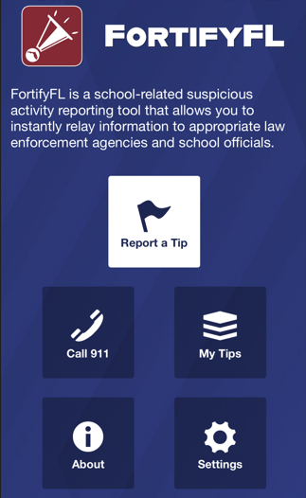
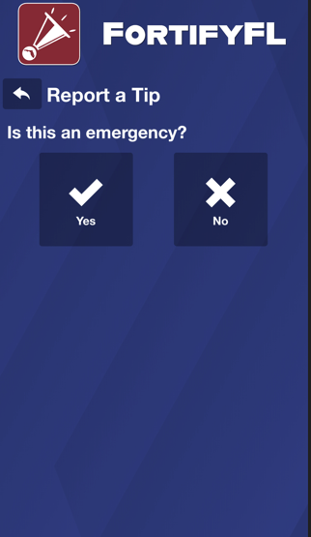
How do I submit a tip in the app?
Click “Report a Tip” and indicate if it is an emergency

Slide 10
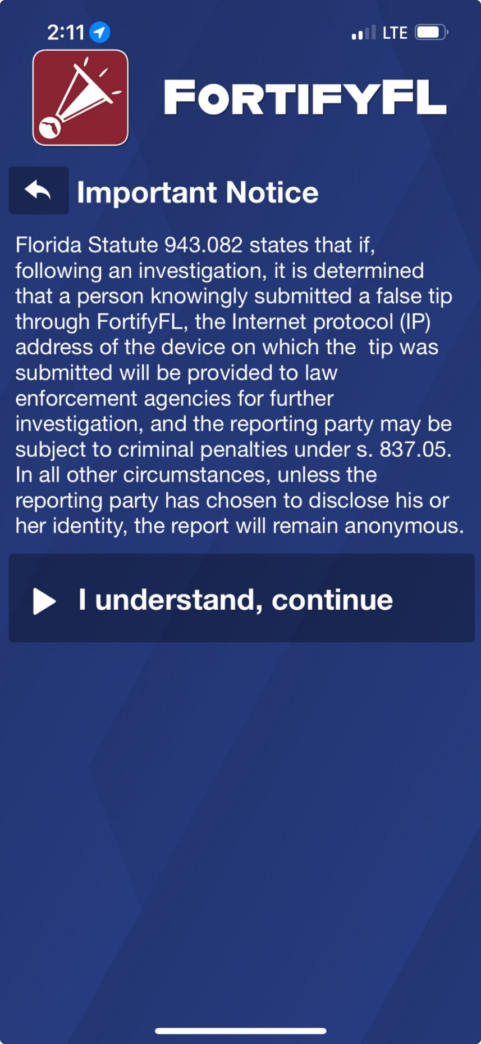
How do I submit a tip?
Important Notice:
Per Florida law if someone knowingly submitted a false tip through FortifyFL, device information will be provided to law enforcement, and the individual could be subject to criminal penalties.
Notes:
It is important to understand that knowingly submitting a false tip through FortifyFL is a serious offense (a 3rd degree felony).

Slide 11
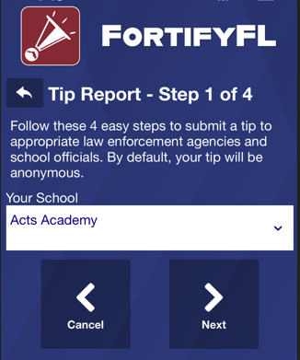
How do I submit a tip?
Step 1:
Select Your School

Slide 12
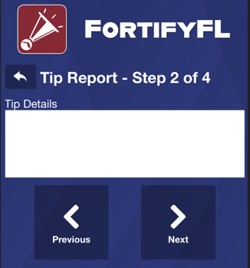
How do I submit a tip?
Step 2:
Provide Your Tip
Be sure to give enough information to get the right kind of help.
A student on my bus (#302) had a gun he was showing off. I don’t know his name but he’s got red hair and wearing a light gray hoodie with a triangle logo on it.
Notes:
The tip reads, “A student on my bus (#302) had a gun he was showing off. I don’t know his name but he’s got red hair and wearing a light gray hoodie with a triangle logo on it.”
This tip includes:
WHO - a student on bus 302 with red hair and wearing a light gray hoodie
WHAT - a gun
WHERE - on bus 302
This tip has good information; it’s missing the WHEN – did this happen this morning? Last week?
Tips are useful when they include actionable information.
Please provide enough detail.
Some examples of tips that are not as useful – taken from FortifyFL:
Someone posted a pic on snap of a gun saying he will shoot up the school on may 20th im scared
Student assaulted a teacher by kicking and punching her.
There's a girl in the hallway taking about framing a boy
there was a threat i am scared
Mutual friend was shown a gun in the classroom
This one boy keeps following me to my classes and tried to give me a hug and kiss
Individual is posting disturbing content on his social media, threatening to “kill the ***s”, posting about explosives etc
Vague information is not helpful – if someone is in crisis, who? If there is unsafe activity on campus – where?

Slide 13
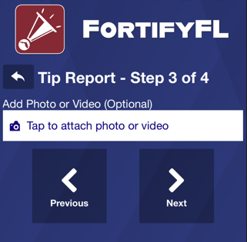
How do I submit a tip?
Step 3: Attach an Optional Photo or Video

Slide 14
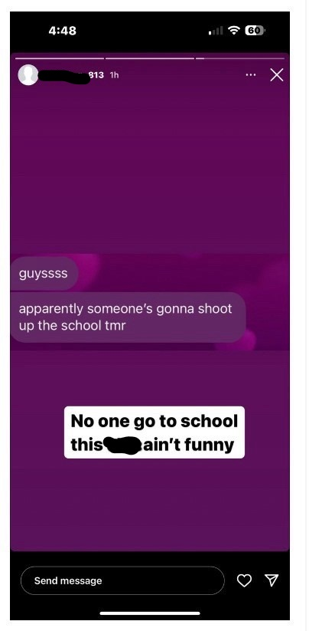
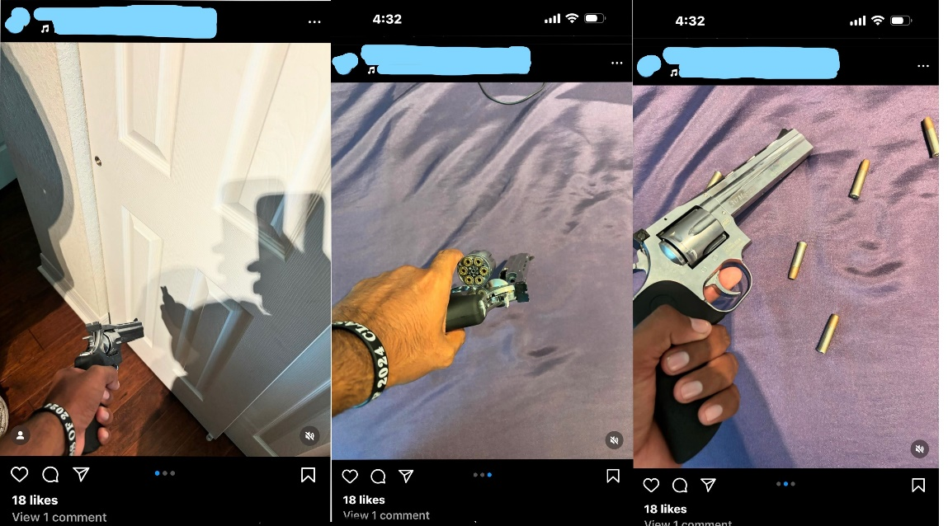
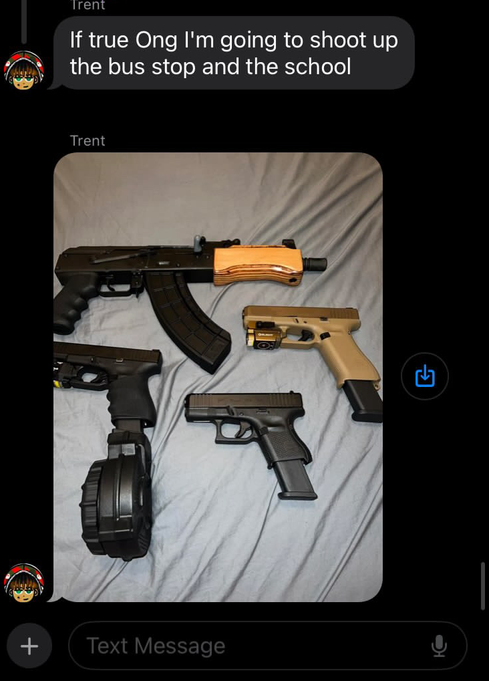
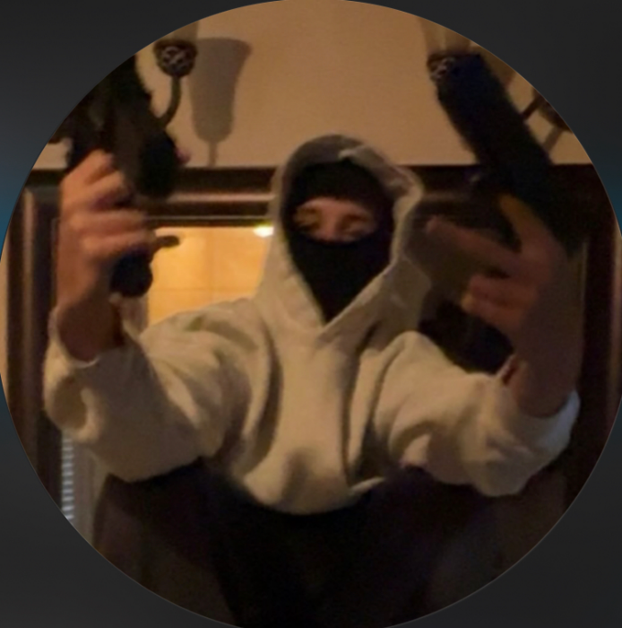
Example of Photo or Video
Notes:
FDLE note: Examples of Photographs and video sent to Fortify Florida

Slide 15
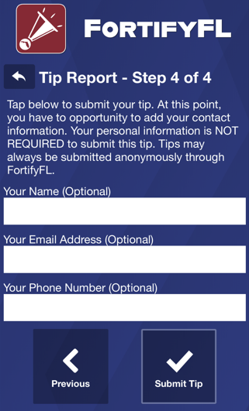
How do I submit a tip?
Step 4:
Provide Optional Information and Submit Your Tip
Notes:
If there is a need to remain anonymous, then skip this section. If you are worried that others will know about your tip, just remember that your tip is not public. When you include your name and other information, you help those who may need to ask you questions.

Slide 16

Check out this video about FortifyFL
Notes:
On February 14, 2018, at Marjory Stoneman Douglas High School, 17 people were killed and another 17 were seriously injured in a school shooting.
The shooter exhibited many warning signs that he was on the path to violence. Following this tragic event, investigators learned that numerous people – mostly fellow students – knew about concerning statements and behaviors attributed to the shooter leading up to February 14, 2018.
FortifyFL is a tool that you can use if you know about someone wanting to hurt themselves or others.

Slide 17
What happens after I submit a tip?
Once you have provided the information to the school anonymously or in person, the School Based Threat Management Team will immediately start an assessment to determine if the person does have intentions of harming self or others.
If a threat exists, the school team will take action to keep everyone safe.
Notes:
Every school must have a School Based Threat Assessment Team that includes school administrators, school counselors, school teachers and law enforcement. It is their job to assess the situation and take the appropriate steps.

Slide 18
What if I am not sure if it is a threat or concerning behavior?
Report it immediately and allow your School Based Threat Management team to investigate!
Notes:
If you aren’t sure if the behavior is truly concerning, report it anyway and let the school team take it from there! You will never be at fault for making a report that turns out to be unfounded or not a concern.

Slide 19



Thank you for helping to keep our school and community safe
Notes:
Reporting through FortifyFL keeps us all safe.
Thank you.
For the teacher - If there are questions about why we have FortifyFL, here is the history:
FortifyFL was created and funded by the 2018 Florida Legislature as part of the Marjory Stoneman Douglas High School Public Safety Act. The application was named by students from Marjory Stoneman Douglas High School. The Office of Attorney General, Department of Education and Florida Department of Law Enforcement coordinated its development and roll-out.

